Slide 1
MOSFET
Metal-Oxide-Semiconductor Field- Effect Transistor are a specialized type of FET
Offer enhanced performance and efficiency due to their unique structure and operation.
MOSFET is a voltage controlled device that regulates the flow of current.
It consists of three main terminals: the gate, source, and drain.
The voltage applied to the gate terminal controls the conductivity of the device,
allowing it to switch on or off, or to amplify signals.
This makes MOSFETs essential components in various electronic devices, including computers, smartphones, and power systems.

Slide 2
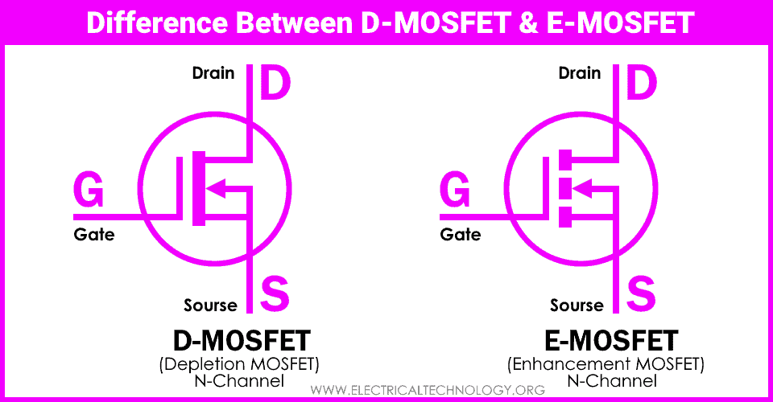

Slide 3
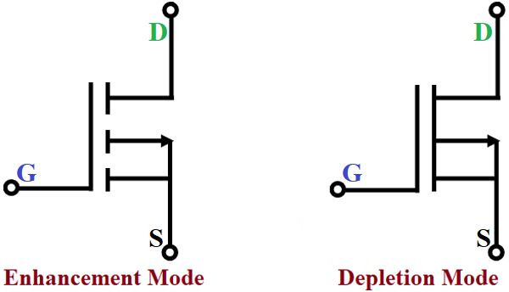
P-Channel MOSFET

Slide 4
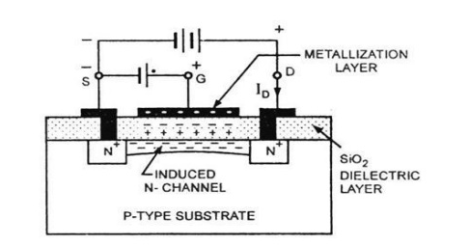
N-Channel Enhancement MOSFET

Slide 5
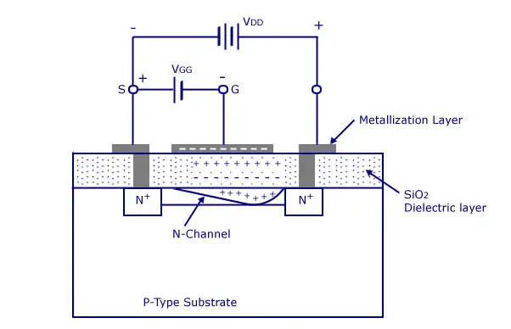
N-Channel Depletion MOSFET

Slide 6
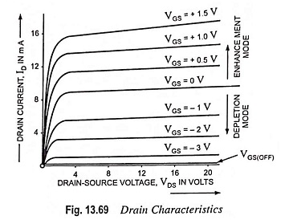
Drain Characteristics of MOSFET

Slide 7
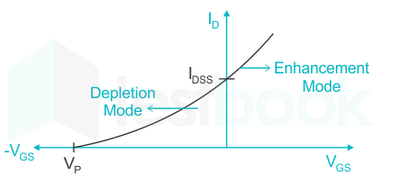
Transfer Characteristics of MOSFET

